Slide 1
Strategic Management
Dr. Marwa Tarek
6th class
Generating strategies

Slide 2
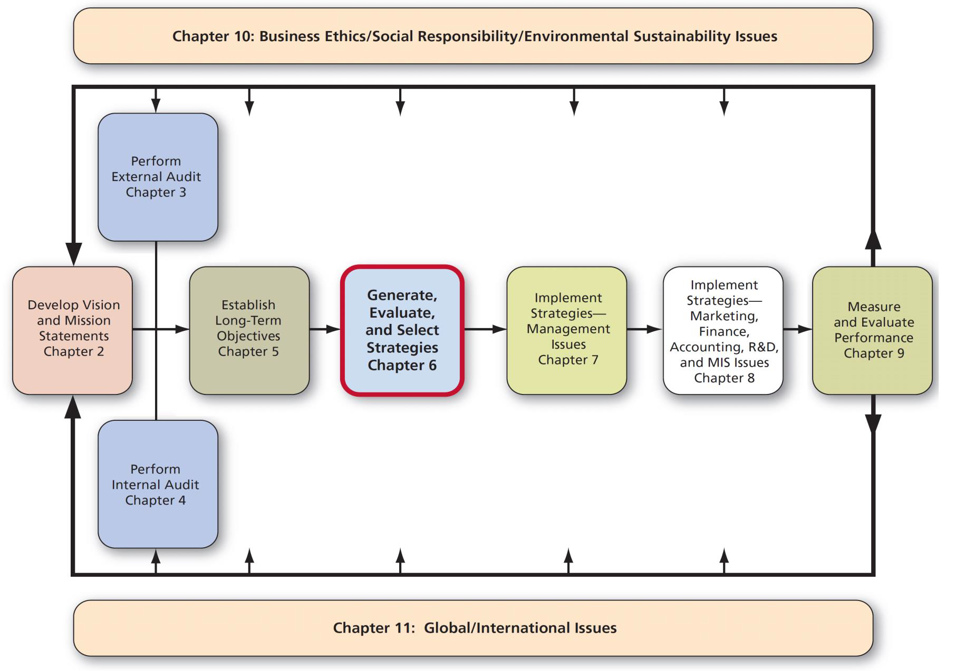
Strategy Analysis & Choice

Slide 3
Comprehensive Strategy-Formulation Framework
Stage 1: The Input Stage Summarizes the basic input information needed to formulate strategies.
Stage 2: The Matching Stage Focuses on generating feasible alternative strategies by aligning key external and internal factors to have the best match between organization’s internal resources & skills and the opportunities & risks created by its external factors.
Stage 3: Decision Stage Is the final stage in strategy formulation phase.

Slide 4
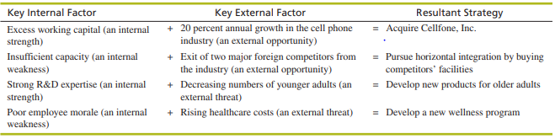
Comprehensive Strategy-Formulation Framework
Stage 2: The Matching Stage Focuses on generating feasible alternative strategies by aligning key external and internal factors to have the best match between organization’s internal resources & skills and the opportunities & risks created by its external factors.

Slide 5
Comprehensive Strategy-Formulation Framework
Stage 1 –Input Stage
EFE (External Factor Evaluation) Matrix
IFE (Internal Factor Evaluation) Matrix
Stage 2 –Matching Stage (ready to achieve the best fit)
Qualitative tool:
TOWS
Quantitative tools:
IE (Internal-External) Matrix
BCG (Boston Consulting Group) Matrix
SPACE (Strategic Position & Action Evaluation)Matrix
Stage 3 –Decision Stage
QSPM (Quantitative Strategic Planning Matrix)

Slide 6
Comprehensive Strategy-Formulation Framework
Stage 2: The Matching Stage
TOWS (Strengths-Weaknesses-Opportunities-Threats)
Strengths: factors that give an edge for the company over its competitors.
Weaknesses: factors that can be harmful if used against the firm by its competitors.
Opportunities: favorable situations which can bring a competitive advantage.
Threats: unfavorable situations which can negatively affect the business.

Slide 7
Comprehensive Strategy-Formulation Framework
Stage 2: The Matching Stage
Understanding the Difference Between Qualitative vs. Quantitative Strategy Tools
You are differentiating between:
1) Qualitative tool → TOWS Matrix
2) Quantitative tools → IE Matrix, SPACE Matrix, BCG Matrix
1) QUALITATIVE Tool — TOWS Matrix
TOWS is qualitative, meaning it depends on thinking, judgment, and combining internal and external factors.
🔹 TOWS generates 4 types of strategies:
1. Corporate / Growth strategies
2. Integration strategies
3. Defensive strategies
4. Business-level (generic) strategies: cost leadership, differentiation, focus
This is because TOWS allows any strategic alternative that matches S, W, O, T.
It is flexible and can produce all strategy types depending on how you combine factors.

Slide 8
Comprehensive Strategy-Formulation Framework
Stage 2: The Matching Stage
⭐ 2) QUANTITATIVE Tools — IE, SPACE, BCG
🔹 These tools use numbers, weights, scores, and matrices.
They focus on the overall strategic position of the company.
They typically produce only 3 categories:
1. Corporate strategies (growth / expansion)
2. Integration strategies
3. Defensive strategies
❗ They do NOT produce:
Business-level (generic) strategies,
because these matrices work at the corporate level, not at the business-unit level.
⭐ Why Quantitative Tools Do NOT Generate Business Strategies
Because:
• IE Matrix, SPACE Matrix, and BCG Matrix evaluate the organization at the macro/corporate level
• Their output is a direction, not a competitive method
(e.g., Grow, Hold, Harvest, Divest – not Cost Leadership or Differentiation)
Generic strategies (Porter) are competitive strategies within a single business unit, not corporate strategy directions.

Slide 9
Comprehensive Strategy-Formulation Framework
Stage 2: The Matching Stage
⭐ 3) WHY do we use Quantitative Tools?
Here is the deep meaning:
✔ 1. To validate the qualitative results of TOWS
TOWS is subjective → depends on managerial interpretation.
Quantitative tools test whether the numbers point in the same direction.
________________________________________
✔ 2. To check consistency and accuracy
If TOWS suggests growth, quantitative matrices should also place the company in:
• Grow and build
• Aggressive
• Stars / Question Marks
If both results match → the strategy is solid.
If not → there is a mismatch that must be investigated.
________________________________________
✔ 3. To reduce bias and manager preference
Humans may want a certain strategy emotionally.
Quantitative tools force the decision to be based on data.
________________________________________
✔ 4. To make strategy selection evidence-based
Boards and CEOs prefer numbers, not opinions.
Quantitative tools provide numerical justification.
________________________________________

Slide 10
Comprehensive Strategy-Formulation Framework
Stage 2: The Matching Stage
✔ 5. To narrow down the strategic direction
TOWS gives many alternatives.
Quantitative tools select the most realistic and suitable one.
________________________________________
⭐ Perfect Final Explanation (Use This in Exams or Lectures)
TOWS is a qualitative tool that generates four types of strategies, including business-level strategies, because it relies on logical combinations of internal and external factors. Quantitative tools such as the IE Matrix, SPACE Matrix, and BCG Matrix generate only three types—corporate, integration, and defensive strategies—because they operate at the corporate level and provide strategic direction rather than competitive (generic) strategies. We use the quantitative tools to validate and confirm the results of TOWS, reduce subjectivity, and ensure that both qualitative judgment and numerical analysis lead to the same strategic choice.
________________________________________
⭐ Why BCG Cannot Assign Business Strategies (Porter’s Generic Strategies)
Even though BCG is used for different products or business units, it still cannot generate business-level (generic) strategies like:
• Cost Leadership
• Differentiation
• Focus

Slide 11
Comprehensive Strategy-Formulation Framework
Stage 2: The Matching Stage
Why?
Because BCG is NOT designed to tell you how to compete.
It is only designed to tell you what to do with each business unit or product.
________________________________________
⭐ 1️⃣ BCG Tells You “Strategic Direction” (Corporate Decisions)
BCG places each product/business unit into one of four categories:
• Stars → Invest / Grow
• Cash Cows → Hold / Maintain
• Question Marks → Invest selectively / grow or divest
• Dogs → Harvest / Divest
👉 These are corporate-level decisions, not competitive strategies.
BCG answers:
✔ Which products should we grow?
✔ Which should we support with investments?
✔ Which ones do we harvest or divest?
BCG does NOT answer:
✘ Should we use cost leadership?
✘ Should we differentiate?
✘ Should we use focus strategy?
________________________________________

Slide 12
Comprehensive Strategy-Formulation Framework
Stage 2: The Matching Stage
⭐ 2️⃣ BCG Looks at “Portfolio Positioning,” Not Competition Method
BCG uses two metrics:
1. Relative market share
2. Market growth rate
These two numbers cannot tell you:
• if the product should be differentiated
• if the company should reduce cost
• if the product should focus on a niche
Because competitive strategy depends on:
• Cost structure
• Product uniqueness
• Capabilities
• Customer segments
• Value proposition
These factors are NOT included in the BCG model.
________________________________________
⭐ 3️⃣ Business (Generic) Strategies Come From Porter — Not BCG
Porter’s Generic Strategies model is based on competitive advantage, while:
• BCG is based on market position & growth
• IE Matrix is based on IFE & EFE scores
• SPACE Matrix is based on 4 strategic dimensions
These tools operate at the corporate level to guide allocation of resources, not competition methods.
________________________________________
⭐ 4️⃣ BCG Gives Direction; Generic Strategies Give Competitive Method
Think of it this way:
🔹 BCG (Corporate Strategy):
• Should we grow this product?
• Should we invest heavily?
• Should we harvest it?
• Should we divest it?
🔹 Generic Strategies (Business Strategy):
• Will we grow through cost leadership?
• Or grow through differentiation?
• Or grow through focus?
BCG tells you what to do.
Generic strategies tell you how to do it.
________________________________________
⭐ 5️⃣ Even if BCG shows a product is a Star → it still doesn’t tell you the competitive method
Example:
A product is in the Star quadrant.
BCG tells you:
• High growth market
• Strong market share
👉 Invest and grow
But to grow, you must choose:
• Cost leadership?
• Differentiation?
• Focus?
BCG cannot answer that because it lacks competitive variables.
________________________________________
⭐ THE FINAL EXAM-READY ANSWER
Although the BCG Matrix is used to analyze different products or business units, it cannot assign business-level (generic) strategies because it only provides corporate-level portfolio decisions based on market growth and relative market share. BCG answers “what to do” with each unit (grow, hold, harvest, divest), but it does not analyze competitive advantage, value proposition, cost structure, or differentiation factors that are essential for choosing generic strategies. Therefore, BCG cannot generate business strategies such as cost leadership or differentiation.

Slide 13
Comprehensive Strategy-Formulation Framework
(Strategy formulation) not selection
Before the formulation we have to determine the Types of strategies:
Corporate strategies (growth strategies)
Integration strategies
Defensive strategies
Business strategies (generic strategies)
Matching tools
1- Qualitative tool >>> TOWS>>> generate (1-2-3-4)
2- Quantitative tool >>>IE Matrix- Space- (BCG)>>generate (1-2-3) only.
Why we are using quantitative??? to validate the results of TOWS and to ensure that the results are the same.

Slide 14
Comprehensive Strategy-Formulation Framework
1 Quantitative Matrix
1-IE Matrix:
What is the IE Matrix?
The Internal–External (IE) Matrix is a strategic management tool used to Identify which strategy is most appropriate.
It combines internal performance (strengths/weaknesses) and external environment (opportunities/threats)
✔ It is quantitative because it uses numerical scores derived from IFE and EFE.

Slide 15
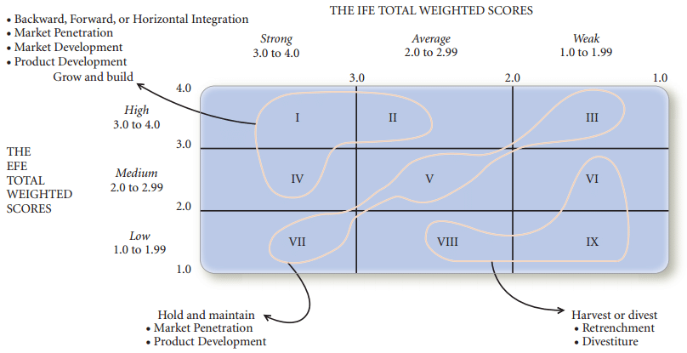
Comprehensive Strategy-Formulation Framework
1 Quantitative Matrix
IE Matrix

Slide 16
Comprehensive Strategy-Formulation Framework
IFE =3.5 and EFE=2.5
Intersection Point will lead to standardized strategies that you have to stick to, to select one of these proposed strategies later.
1- Harvest or divest (Reduce exposure or exit the business).
2-Hold and maintain (Maintain stability and improve efficiency).
3- Grow and build (Aggressive growth is appropriate)

Slide 17
Comprehensive Strategy-Formulation Framework
Stage 2: The Matching Stage
SWOT Matrix (TWOS Analysis)
Qualitative tool
It is very important
Four types of strategies
Strengths-Opportunities (SO)
Maxi-Maxi. (max strengths to max opportunités)
Weaknesses-Opportunities (WO)
Mini-Maxi. (min. weaknesses to max opportunités)
Strengths-Threats (ST)
Maxi-Mini. (max strengths to min. threats)
Weaknesses-Threats (WT)
Mini-Mini.(min weaknesses to min. threats)

Slide 18
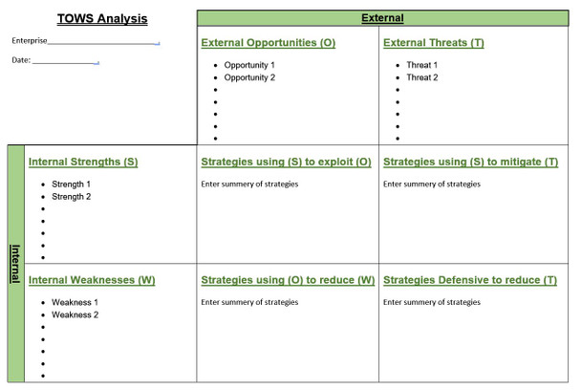
Comprehensive Strategy-Formulation Framework
Stage 2: The Matching Stage
SWOT Matrix (TWOS Analysis) Matching tool - Qualitative tool

Slide 19
Comprehensive Strategy-Formulation Framework
“TOWS does not give you the name of the strategy.
It gives you the logic and the actions that lead you to choose the right strategy.
The matrix is action-driven.
The strategy categories we studied are decision-driven.
You first generate actions through TOWS, then translate them into the formal strategies you learned in class.”
SO Example from TOWS:
“Use our strong brand reputation (S) to enter Gulf markets where demand is rising (O).”
This is an action-oriented statement.
But what category does it belong to? → Market Development Strategy

Slide 20
Comprehensive Strategy-Formulation Framework
Stage 2: The Matching Stage
SWOT Matrix (TWOS Analysis) Matching techniques- Qualitative tool
TOWS | External Opportunities 1- Limited competition 2-Increase consumer spending 3- High penetration rate of internet 4- Market growth 20% 5- Government support 6- Market gap ((Upper Egypt) | External threats
Internal strengths After sale service 10 M. EGP marketing budget Good distribution channels Trained team Market leader 30% CRM Quality Brand name | SO Strategies S1,S2,S3,S7,S8,O1 1- (you have to write Statement,….. increasing market share) 2-Growth strategies Conditions 1st condition: Start with the product (existing) so market penetration or market development 2nd condition: Start with the new market (3 conditions) Is it new segment? No New place online or offline? No New Business No So you are in market penetration through Generic strategies Conditions …. (how to compete) Differentiation (5 items) product diff. (quality) Brand name-distribution – (promotion )10 m. marketing budget | ST Strategies

Slide 21
Comprehensive Strategy-Formulation Framework
TOWS | External Opportunities 1- Limited competition 2-Increase consumer spending 3- High penetration rate of internet 4- Market growth 20% 5- Government support 6- Market gap ((Upper Egypt) | External threats
Internal strengths After sale service 10 M. EGP marketing budget Good distribution channels Trained team Market leader 30% CRM Quality Brand name | SO Strategies S6,S2,S4,O3 Growth strategies Existing product-New market (market development) Through …….Generic st. Product uniqueness Product differentiation S2,S5,S3,S5,S8, O2 (Statement…) Growth strategies Existing product-Existing market (market penetration) Through …….Generic st. Generic strategies Product uniqueness Product differentiation S2,S8, S5, O4 (Statement…) Existing product-Existing market (market penetration) through …….Generic st. Generic strategies Product uniqueness Product differentiation | ST Strategies
In real life you have to benefit from all opportunities.

Slide 22
Comprehensive Strategy-Formulation Framework
TOWS | External Opportunities 1- Limited competition 2-Increase consumer spending 3- High penetration rate of internet 4- Market growth 20% 5- Government support 6- Market gap ((Upper Egypt) | External threats
Internal weaknesses No digital team | WO Strategies (Growth strategies only) as we cannot compete with my weaknesses, So no Generic strategies are recommended (business strategies) as a competition comes from my strengths not weaknesses. W1,O3, O4 In WO, You have to propose an action In your statement to be implemented To get mandatory tactics Growth strategies Existing product-New market (market development) as we cannot compete here with our weaknesses. | ST Strategies
In real life you have to benefit from all opportunities.

Slide 23
Comprehensive Strategy-Formulation Framework
Stage 2: The Matching Stage
SWOT Matrix (TWOS Analysis) - Qualitative tool
After TOWS we have a lot of strategies
At the end, you have to write the recommended strategies
Growth stratégies
Market pénétration – Market développement
Business stratégies
Différentiation
All quantitative tools are not generating business stratégies, TWOS only is the qualitative matching tool that propose business strategies

Slide 24
Comprehensive Strategy-Formulation Framework
Stage 2: The Matching Stage
SWOT Matrix
SO strategies use a firm’s internal strengths to take advantage of external opportunities.
WO strategies improve internal weaknesses by taking advantage of external opportunities.
ST strategies use a firm’s strengths to avoid or reduce the impact of external threats.
WT strategies defensive tactics aimed at reducing internal weakness and avoiding external threats to defend its survival.

Slide 25
Comprehensive Strategy-Formulation Framework
Stage 2: The Matching Stage
SWOT Matrix
1. List the firm’s key external opportunities
2. List the firm’s key external threats
3. List the firm’s key internal strengths
4. List the firm’s key internal weaknesses
5. Match internal strengths with external opportunities and record the resultant SO Strategies.

Slide 26
Comprehensive Strategy-Formulation Framework
Stage 2: The Matching Stage
SWOT Matrix
6. Match internal weaknesses with external opportunities, and record the resultant WO Strategies. 7. Match internal strengths with external threats, and record the resultant ST Strategies. 8. Match internal weaknesses with external threats, and record the resultant WT Strategies.

Slide 27
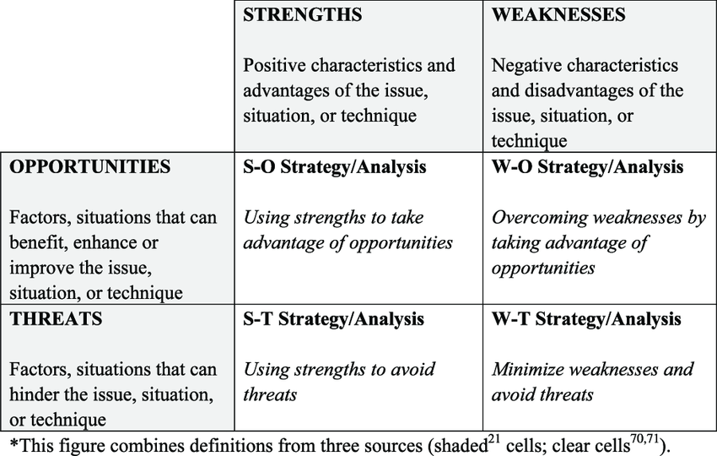
Stage 2: The Matching Stage
SWOT Matrix
SWOT matrix is the most widely used in matching stage as it is simple to do however it generates a wide range of strategies. Also, it may lead the firm to overemphasize a single internal or external factor in formulating strategies.

Slide 28
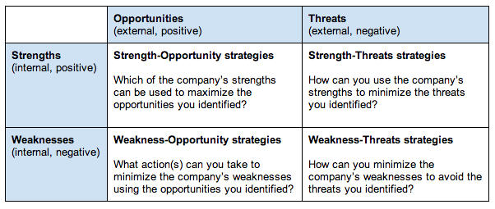
Stage 2: The Matching Stage
SWOT Matrix

Slide 29
Stage 2: The Matching Stage
The Strengths-Weaknesses-Opportunities-Threats (SWOT) Matrix
The SWOT Matrix is an important matching tool that helps managers develop four types of strategies:
SO (strengths-opportunities) Strategies,
WO (weaknesses-opportunities) Strategies,
ST (strengths-threats) Strategies, and,
WT (weaknesses-threats) Strategies.
Matching key external and internal factors is the most difficult part of developing a SWOT Matrix and requires good judgment—and there is no one best set of matches.

Slide 30
Stage 2: The Matching Stage
SWOT Matrix
Example, if a private university has a strong financial position than the other competitors, and it found a critical opportunity in gulf market which may search for more Arab educational entities, so its strategy is to focus on opening a new educational entity in one of the gulf countries.

Slide 31
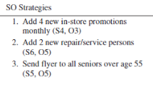
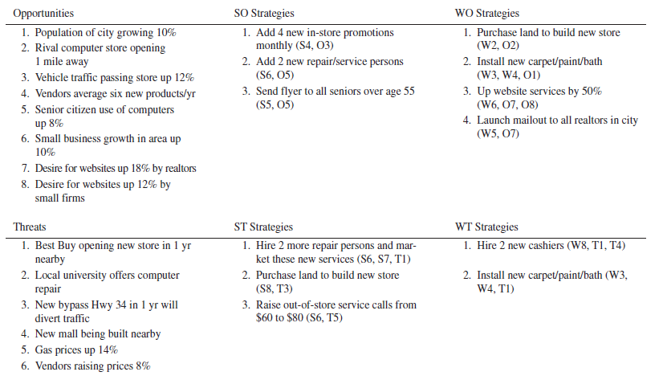
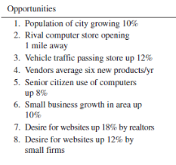
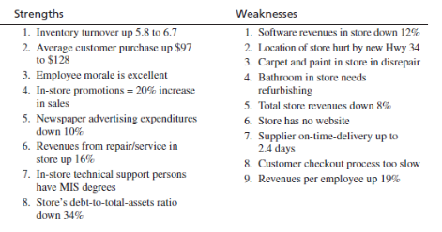
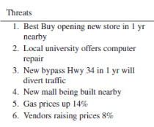
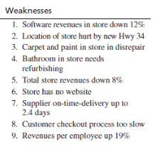
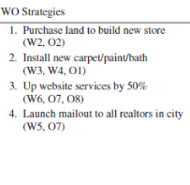
SWOT Matrix
A SWOT Matrix for a Retail Computer store Computer Store

Slide 32
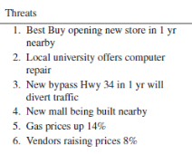
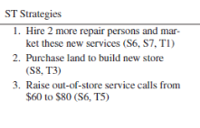
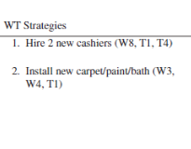
SWOT Matrix
A SWOT Matrix for a Retail Computer store Computer Store

Slide 33
SWOT Matrix
Although the SWOT matrix is widely used in strategic planning, the analysis does have some limitations.
1-Lack of Prioritization: SWOT analysis does not provide a mechanism to prioritize the identified strengths, weaknesses, opportunities, and threats, making it challenging to focus on the most critical factors.
2-No Action Plan: While SWOT identifies key areas, it does not provide a clear roadmap or actionable strategies to address the findings.
3-Risk of Generalization: The analysis might result in generic or vague statements that lack the specificity needed for effective decision-making.
To mitigate these disadvantages, it’s important to combine SWOT analysis with other strategic tools and ensure a data-driven, collaborative approach.

